Slide 1
Genetic Factors Associated with SARS-CoV-2 Susceptibility in Multiethnic Populations Aditya Sriram, M.S. Genetic Epidemiology - 5/25/22 Thesis Committee: Dr. Kathleen Kerr, Dr. Bruce Weir

Slide 2
Background: SARS-CoV-2
Severe acute respiratory syndrome coronavirus 2 (SARS-CoV-2) is a member of the coronavirus family of viruses and specifically causes the disease COVID-19
Greatly heterogenous range of health outcomes
Genetic characterization of SARS-CoV-2 + human host genetic variant analysis → better understanding of COVID-19 genetic components
Tenforde, M. W., Kim, S. S., et al. (2020).

Slide 3
Background: Thesis Aims & Context
Project: conducted a multiethnic genome-wide association study (GWAS) to investigate possible associations between single-nucleotide polymorphisms (SNPs) and susceptibility to SARS-CoV-2 infection
23andMe, AncestryDNA, and the National Institutes of Health have released GWAS results for COVID-19 phenotypes of interest
Existing GWAS for SARS-CoV-2 susceptibility have shown the chr3p21.31 locus to be strongly associated with both severity and susceptibility phenotypes
rs2271616:G>T variant (SLC6A20 locus) has been associated with susceptibility phenotype across multiple studies
Shelton, J. F., Shastri, A. J., et al. (2021); Roberts, G. H. L., Park, D. S., et al. (2020); Thibord, F., Chan, M. v, Chen, M.-H., & Johnson, A. D. (2022); Pairo-Castineira, E., Clohisey, S., Klaric, L., et al. (2021); Downes, D. J., Cross, A. R., et al. (2021)

Slide 4
Addressing GWAS Diversity
General concern about genetic association studies: predominantly European ancestral makeup of study participants
Majority of GWAS across all traits and diseases have been conducted in European-ancestry populations
Multiethnic GWAS aims to provide better information regarding potential causal variants, risk factors, and insights into COVID-19 susceptibility across a greater range of individuals

Slide 5
Methods: Data and Sample Information
Three populations with COVID-19 test results from the UK BioBank imputed dataset V3: EUR (16,551 cases, 81,826 controls), AFR (557 cases, 1,281 controls), and SAS (810 cases, 1,516 controls)
cases were individuals with a laboratory-reported positive test for SARS-CoV-2, and controls were participants who received lab-reported negative test results
SARS-CoV-2 susceptibility was phenotype of interest for this association study
COVID-19 hospitalization, severity, and death merit further exploration
Cross-sectional study
Thibord, F., Chan, M. v, Chen, M.-H., & Johnson, A. D. (2022)

Slide 6
Methods: GWAS Parameters and Setup I
Genotyping: Applied Biosystems™ UK Biobank Axiom™ Array
Imputation: Haplotype Reference Consortium (HRC) reference panel and 1000 Genomes Project phase 3
GWAS for each ancestral population was conducted using SAIGE
accounts for population stratification, sample relatedness and existing case-control imbalance
applies a saddlepoint approximation to control for inflation that may arise from unbalanced case-control ratios
adjusted for age at enrollment, sex, and the ten top principal components of ancestry
Bycroft, C., Freeman, C., et al. (2018); Chen, H., Huffman, J. E., et al. (2019); Zhou, W., Nielsen, J. B., et al. (2018).

Slide 7
Methods: GWAS Parameters and Setup II
Mixed effects logistic regression used to model binary outcome variables
SNPs filtered based on how well-imputed they were (in this case, r² > 0.7) and their minor allele frequencies (MAF > 0.01)
calculated lambda (genomic inflation factor) values ranged from 1.022 to 1.055 in the analyses of each separate ancestry group, indicating no concerns about systematic genomic inflation
SNPs were considered genome-wide significant if they met the widely-accepted threshold of P < 5 x 10⁻⁸

Slide 8
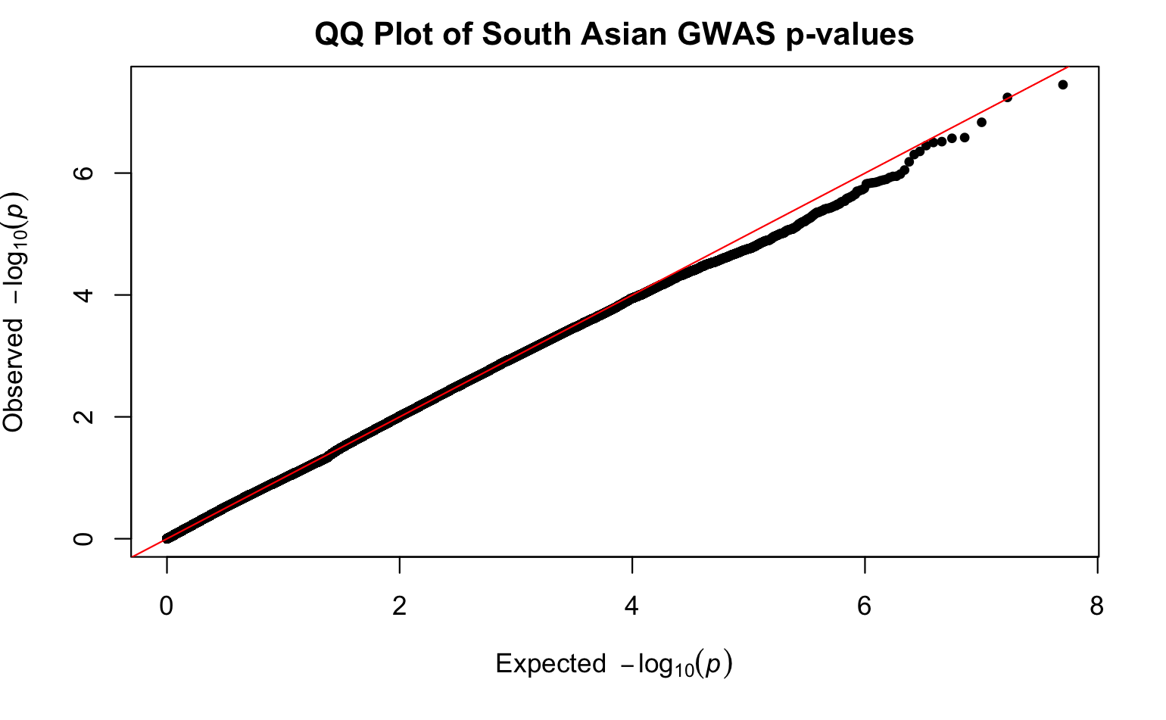
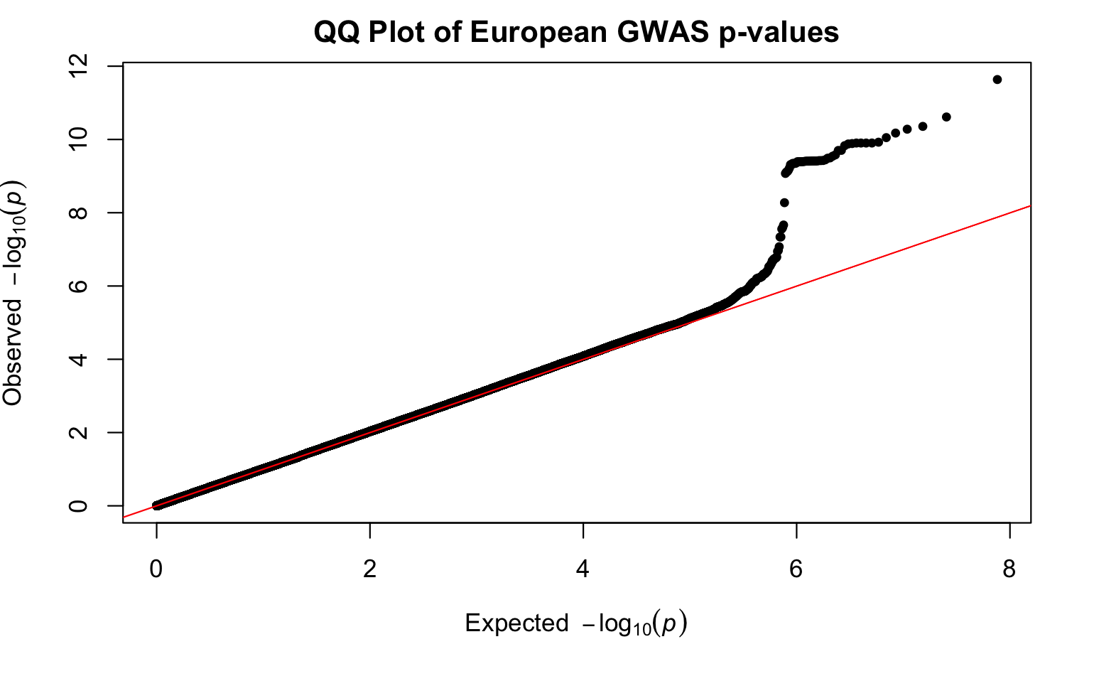
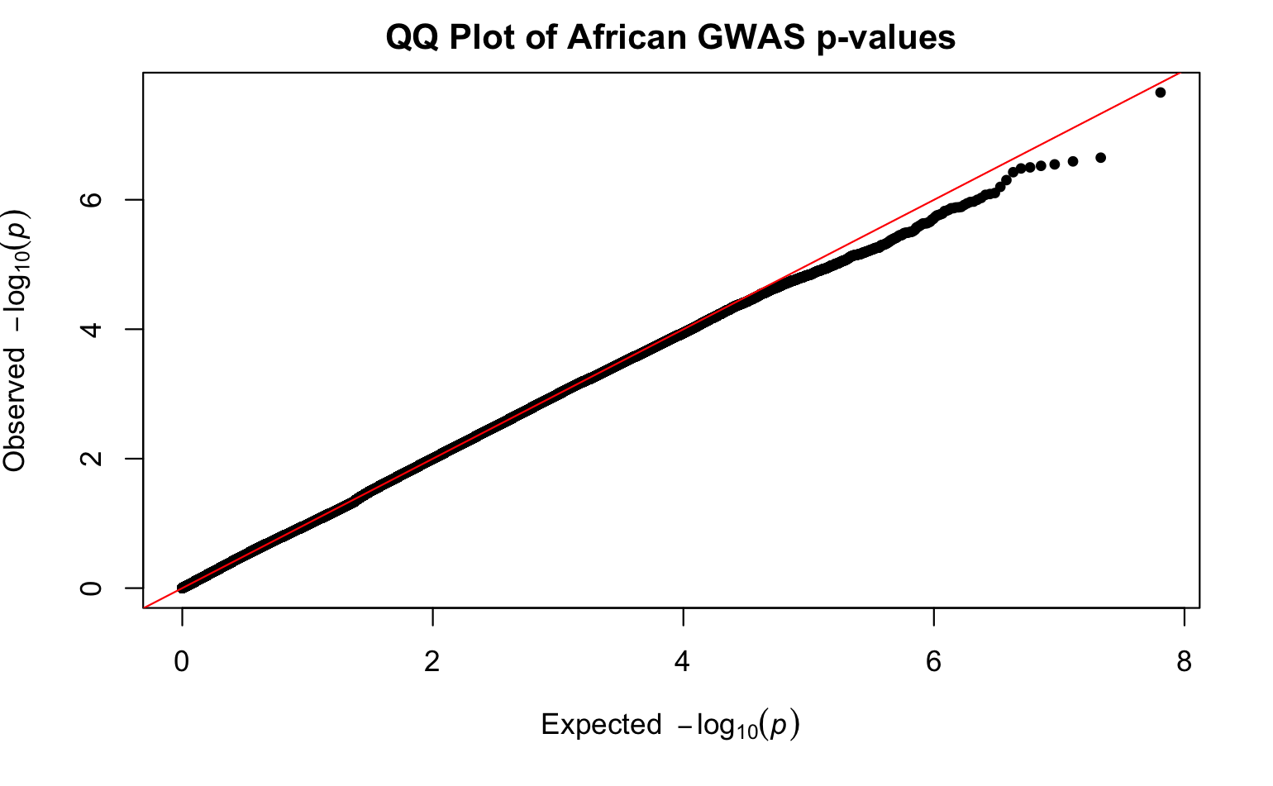
Quantile-Quantile Plots

Slide 9
Methods: Ancestry Comparison
Analysis assessed whether SNP associations with SARS-CoV-2 positive test results from the GWAS in European ancestry generalized to African and South Asian ancestry groups
For a given locus identified in the European ancestry GWAS, I selected the SNP with the smallest p-value to examine for replication
compared size and directionality of effect sizes (beta coefficient values) for SNPs identified in the European ancestry analysis in the other two ancestry groups

Slide 10
Results: European Genome-wide Significant SNPs
Three loci in the European group had associated SNPs that were genome-wide significant (P < 5 x 10⁻⁸):
SLC6A20 in the chr3p21.31 locus (rs73062389-A; P = 2.315 x 10⁻¹²)
ABO (rs9411378-A; P = 2.436 x 10⁻¹¹)
LZTFL1 (rs73062394; P = 4.4 x 10⁻¹¹)
selected the SNPs found in the EUR group for replication in the SAS and AFR populations; in both populations, these signals were not found to be genome-wide significant
likely due to decreased statistical power from the smaller sample sizes
National Center for Biotechnology Information. (2022); National Center for Biotechnology Information. (2022); National Center for Biotechnology Information. (2022); Downes, D. J., Cross, A. R., et al. (2021)

Slide 11
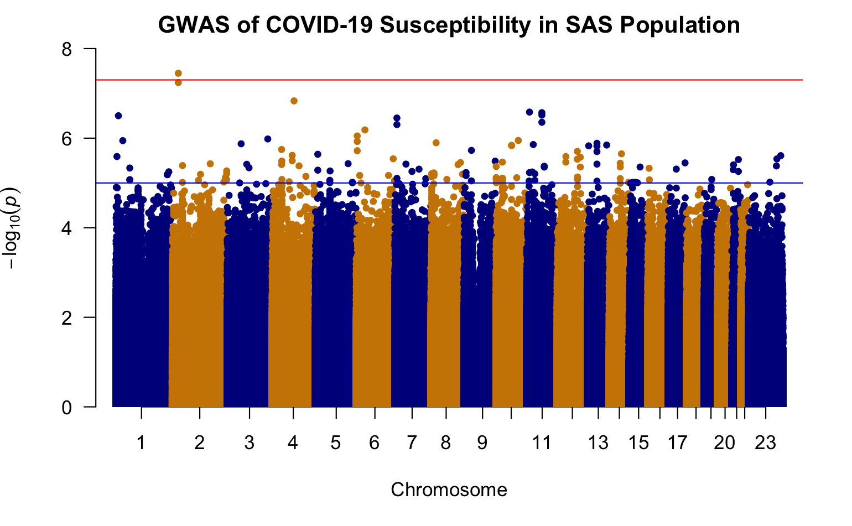
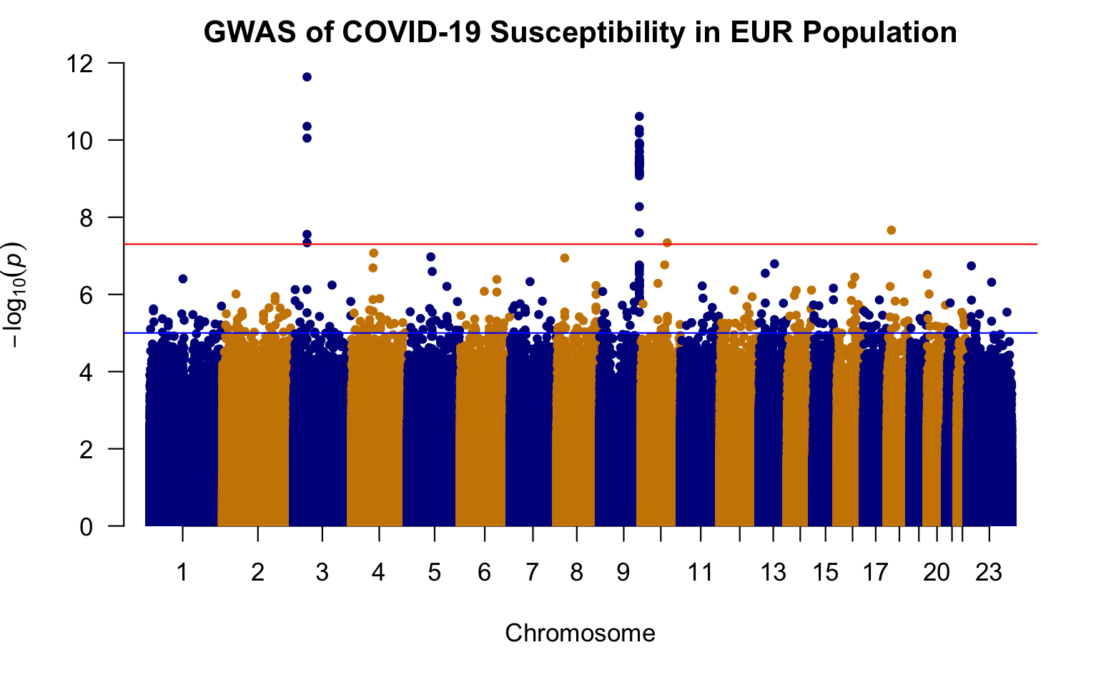
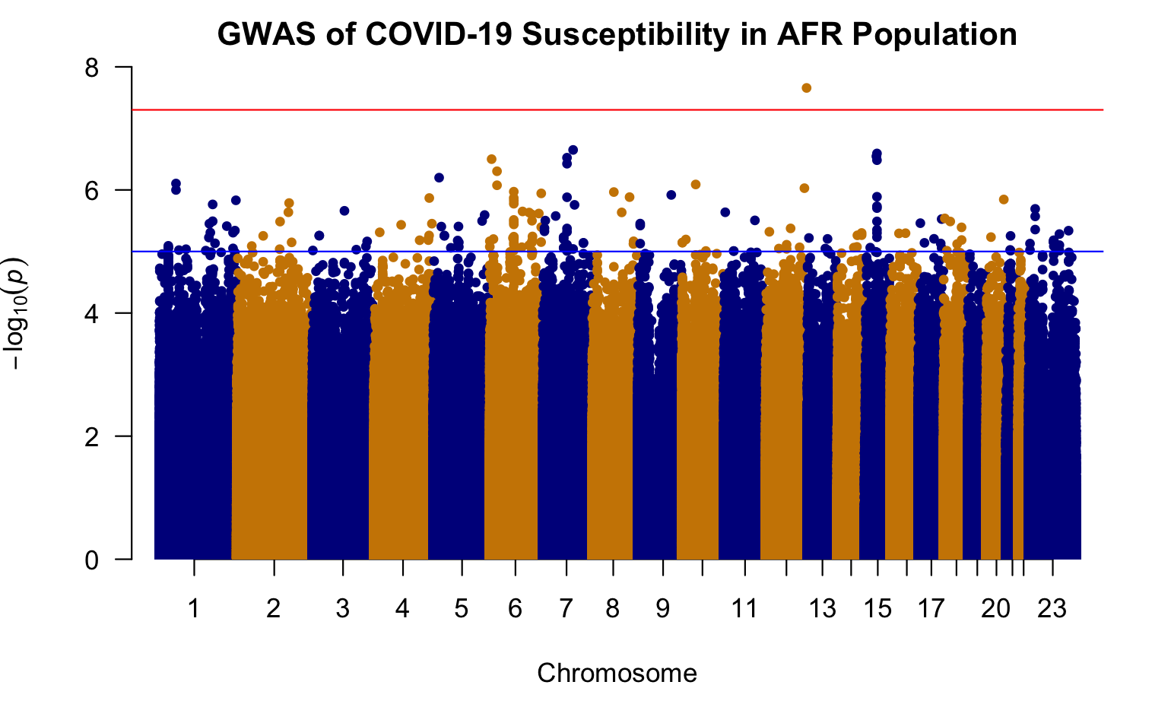
Manhattan Plots

Slide 12
Results: Beta Effect Comparisons + Takeaways
Log-odds ratio comparisons (mixed-effects logistic regression analysis)
rs9411378 (ABO locus):
both the AFR and EUR populations had similar effect sizes and positive directionality (AFR beta coefficient = 0.107, SE = 0.1; EUR beta coefficient = 0.104, SE = 0.0156)
rs73062394 (LZTFL1 locus):
both the AFR and SAS populations had effect sizes with negative directionality (AFR beta coefficient = -0.740, SE = 0.526; SAS beta coefficient = -0.162, SE = 0.219)
opposite direction of EUR ancestry group (beta coefficient = 0.181, SE = 0.0275).
rs73062389 (SLC6A20 locus):
both the EUR and SAS populations had similar effect size and positive directionality (AFR beta coefficient = 0.107, SE = 0.1; EUR beta coefficient = 0.104, SE = 0.0156).

Slide 13
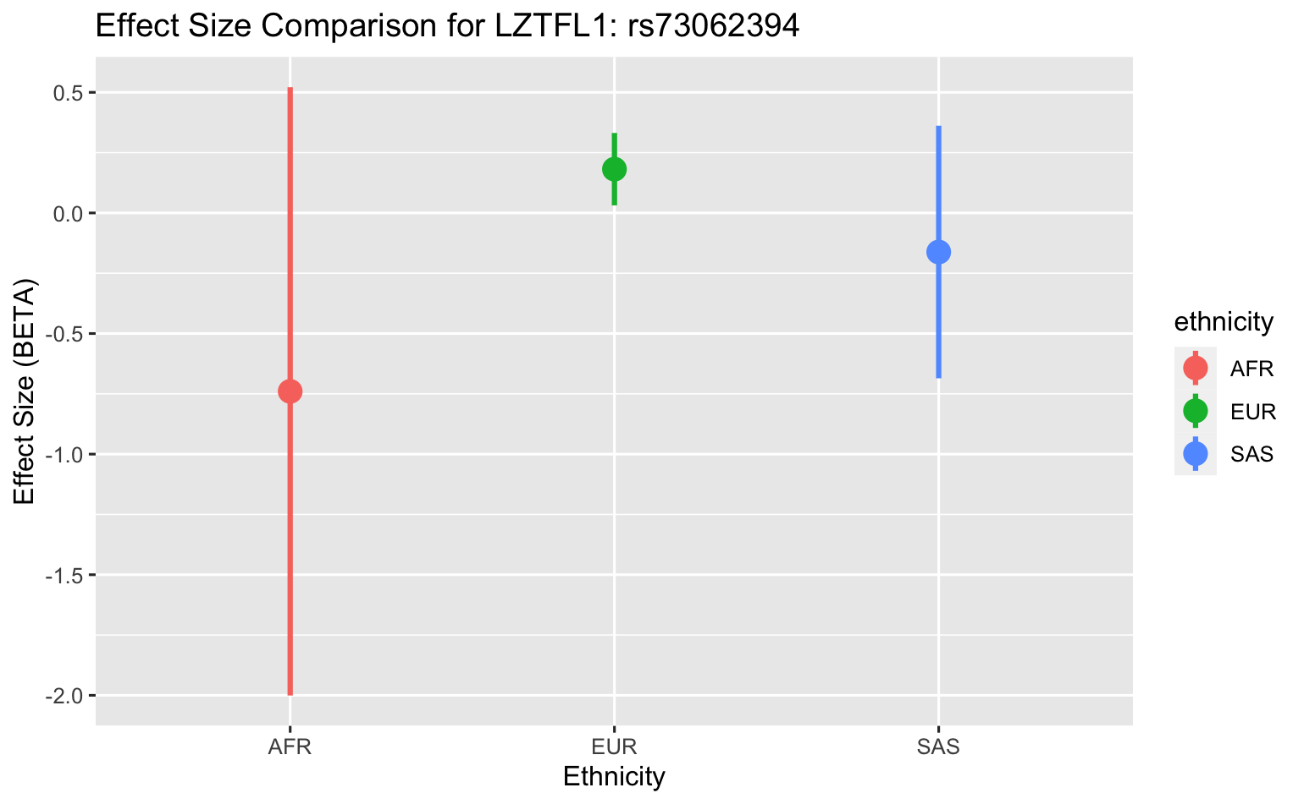
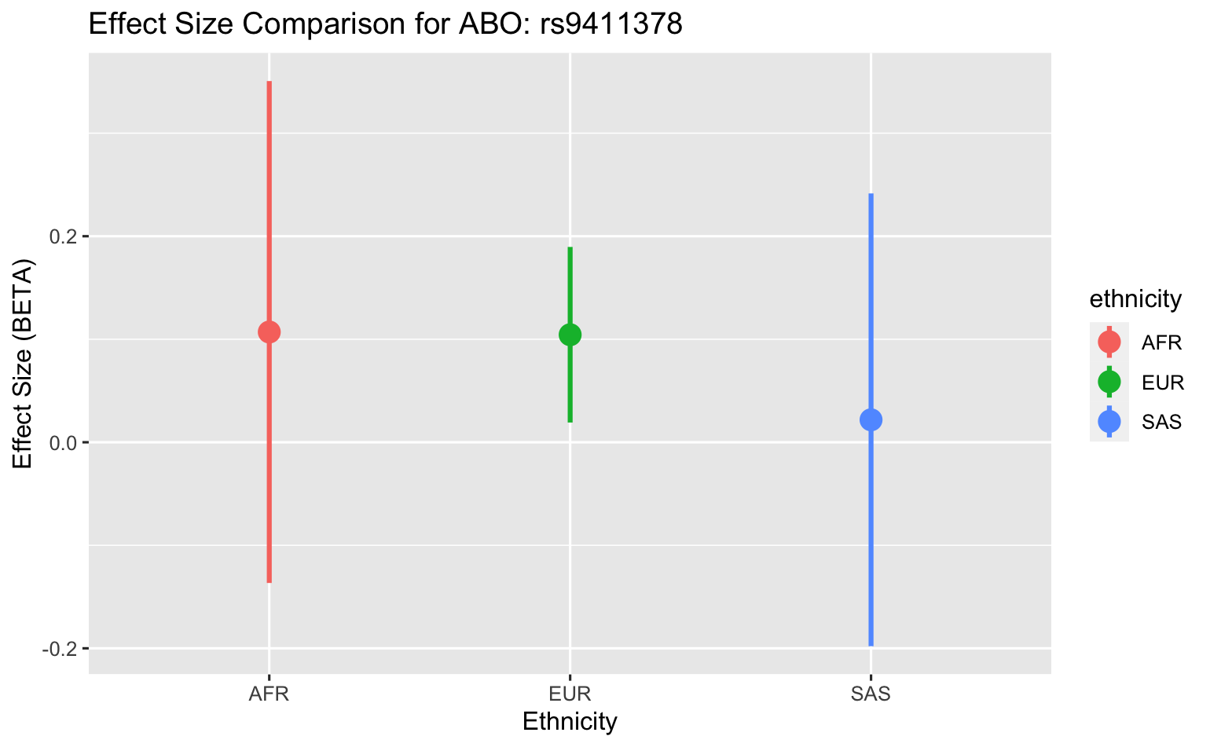
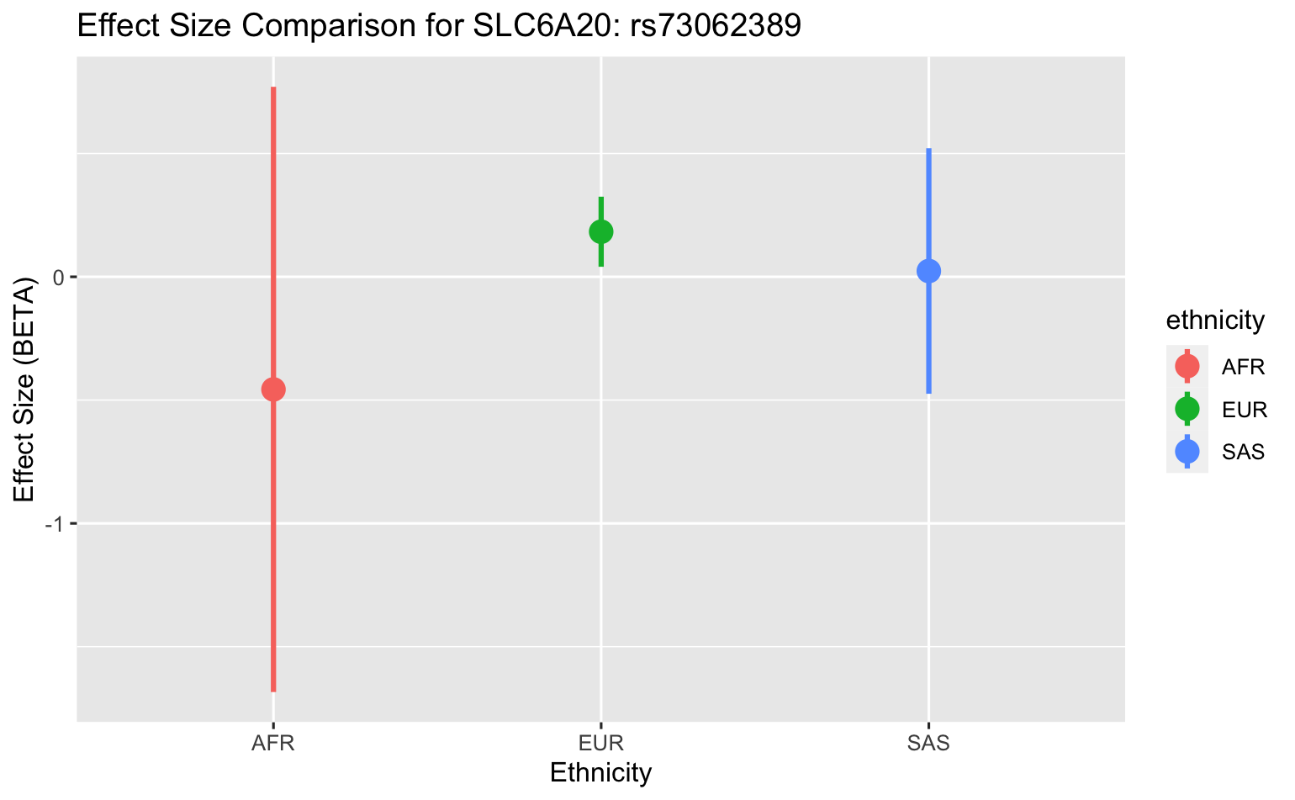
Effect Size Plots

Slide 14
Discussion – ABO locus
encodes the protein responsible for the human blood type determining system
Prior GWAS examining the association between rs9411378, the lead variant corresponding to the ABO locus, and COVID-19 susceptibility determined that the strength of association remained even after controlling for other diseases including cardiovascular conditions and asthma
suggested that bias was not extensively involved in the association between the ABO locus and COVID-19 susceptibility
National Center for Biotechnology Information. (2022); Thibord, F., Chan, M. v, Chen, M.-H., & Johnson, A. D. (2022)

Slide 15
Discussion – LZTFL1 locus
encodes a cytoplasm-localized protein and helps regulate protein trafficking to ciliary membranes
A previous RNA-sequencing study identified increased LZTFL1 expression in ciliated epithelial cells, and these cells are primary cellular targets during SARS-CoV-2 infection
Our results showed negative effect sizes for AFR and SAS populations for rs73062394 at the LZTFL1 locus; may hint at protective role for this locus in these ancestral groups
National Center for Biotechnology Information. (2022); Ravindra, N. G., Alfajaro, M. M., et al. (2021); Wei, Q., Chen, Z.-H., et al. (2016)

Slide 16
Discussion – SLC6A20 locus
encodes a protein that functions as a proline transporter
protein has been found to interact functionally with the ACE2 locus, which has been identified as a SARS-CoV-2 receptor
National Center for Biotechnology Information. (2022); Vuille-dit-Bille, R. N., Camargo, et al. (2015)

Slide 17
Limitations, Caution, and Future Directions
Including diverse ancestries in a GWAS like this brings up study limitations with statistical power, due to smaller sample sizes in non-European ancestral groups
There has not been extensive clinical reporting of the SNPs found in this GWAS
recent nature of SARS-CoV-2 infection
vast heterogeneity of clinical phenotypes resulting from infection
Future studies are required to further understand the genetic and overarching biological implications of these findings

Slide 18
Thank You!

